Slide 1
DSC424 Final Project - Marketing Data
Group1
Milad Sabouri
Isabelle Na Young Choi
Stephanie Olivera
Chien-Lin Yang
Pengju Zhang

Slide 2
Outline
Introduction
Data Exploratory
Regression Analysis
PCA Analysis
LDA Analysis
Clustering Analysis
Conclusion

Slide 3
Introduction
1

Slide 4
Data Source
Our group is going to work on marketing data to analyze a marketing campaign
Data Source:
https://www.kaggle.com/jackdaoud/marketing-data

Slide 5
Data Description
The data has 2240 observations (customers) with 28 variables related to marketing data. More specifically, the variables provide insights about:
Customer profiles
Products purchased
Campaign success (or failure)
Channel performance

Slide 6
Data Exploratory
2
Isabelle Na Young Choi

Slide 7
Data Cleaning
It is cleaning up name of data and missing data.
Data is created a new variable by merging some variables.
Total amount variable
(total_amount <- MntWines, MntFruits, MntMeatProducts, MntSweetProducts, MntGoldProds)
Total number of purchase variable
(total_num_purchase <- NumWebPurchases, NumCatalogPurchases, NumStorePurchases)
Age class variable
(Boomers, Gen-X, Millennials, Gen-Z)
Income class variable
(Rich, Upper-Middle, Middle, Lower-Middle, Poor)

Slide 8
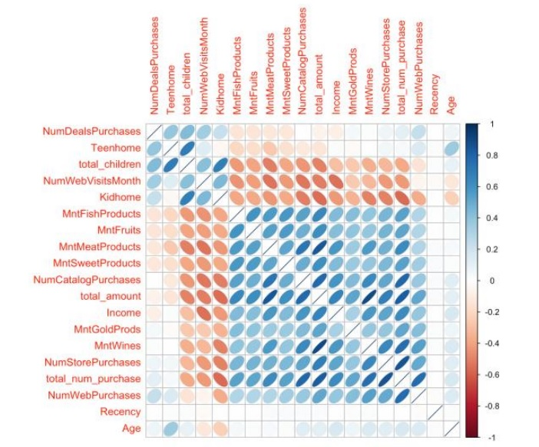
Data Visualization
Numeric vs. Numeric features
The correlation with all numeric features

Slide 9
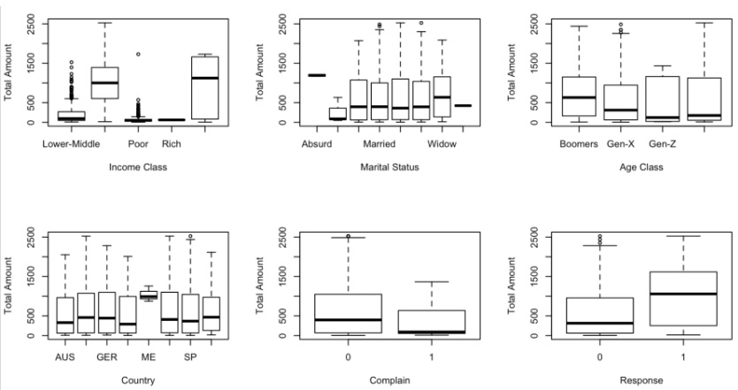
Data Visualization
Categorical vs. Numeric features
The relationship between the total amount feature and the categorical features

Slide 10
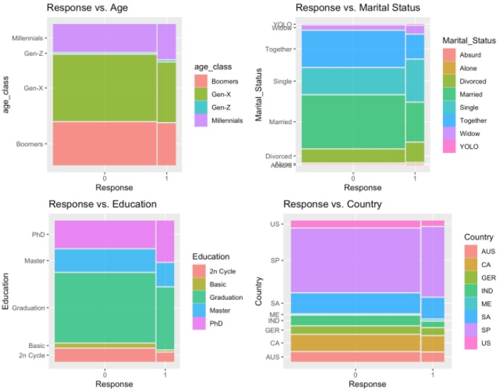
Data Visualization
Categorical vs. Categorical Features
The relationship between the target feature response and 4 different categorical features, age, marital status, education, and country

Slide 11
Regression Analysis
3
Stephanie Olivera

Slide 12
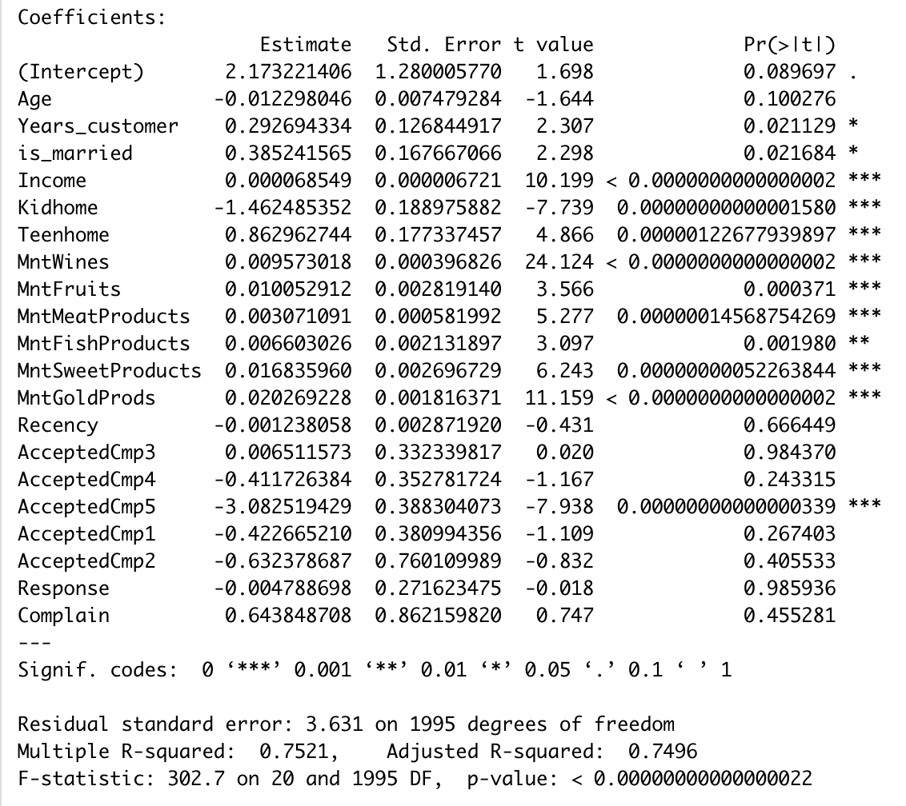
Initial Ordinary Least Squares Regression
Significant Features
Years_customer, is_married, Income, Kidhome, Teenhome, MntWines, MntFruits, MntMeatProducts, MntFishProducts, MntSweetProducts, MntGoldProducts, AcceptedCmp4, AcceptedCmp5
Adjusted-R^2
0.7496
Train RMSE
3.61
Test RMSE
4.52
25% larger Test RMSE than Train RMSE suggests overfitting

Slide 13
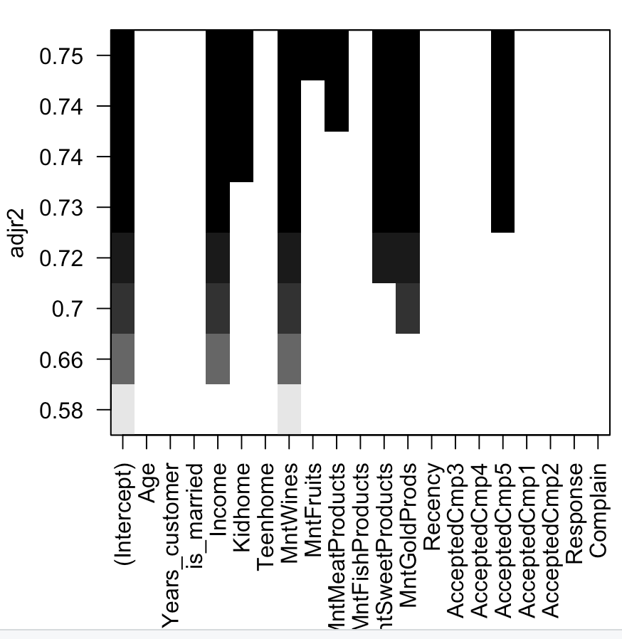
Ordinary Least Squares (All-Subsets)
Significant Features (8)
Age, Kidhome, MntWines, MntFruits, MntMeatProducts, MntSweetProducts, MntGoldProds, AcceptedCmp5
Adjusted-R^2
0.7451
Train RMSE
3.65
Test RMSE
4.71
Slight increase in Train and Test RMSE

Slide 14
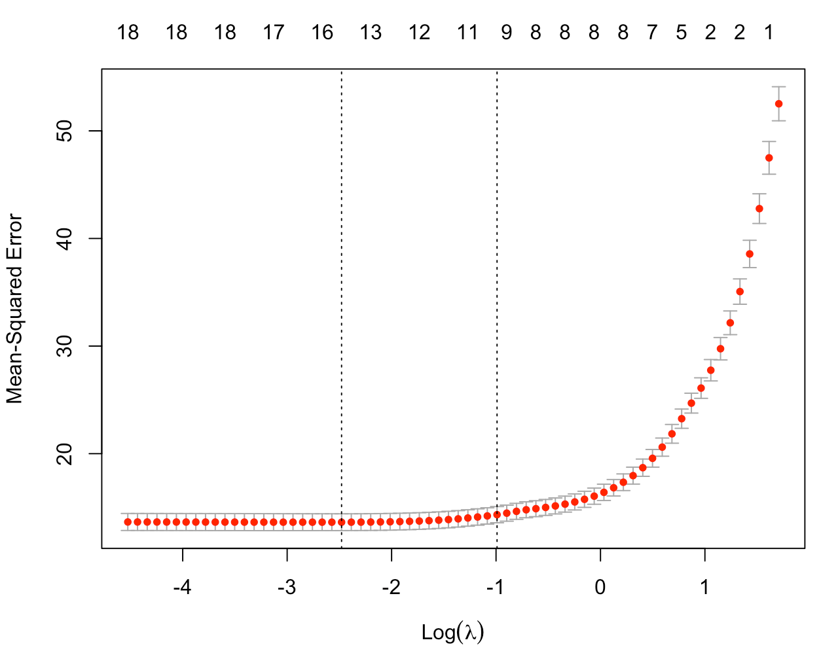
Lasso
Significant Features (10)
Income, Kidhome, Teenhome, MntWines, MntFruits, MntMeatProds, MntFishProds, MntSweetProds, MntGoldProducts, AcceptedCmp5
Income, Teenhome, MntFishProds not previously selected
Adjusted-R^2
0.705
Train RMSE
3.73
Test RMSE
4.64
Test RMSE has decreased from previous model

Slide 15
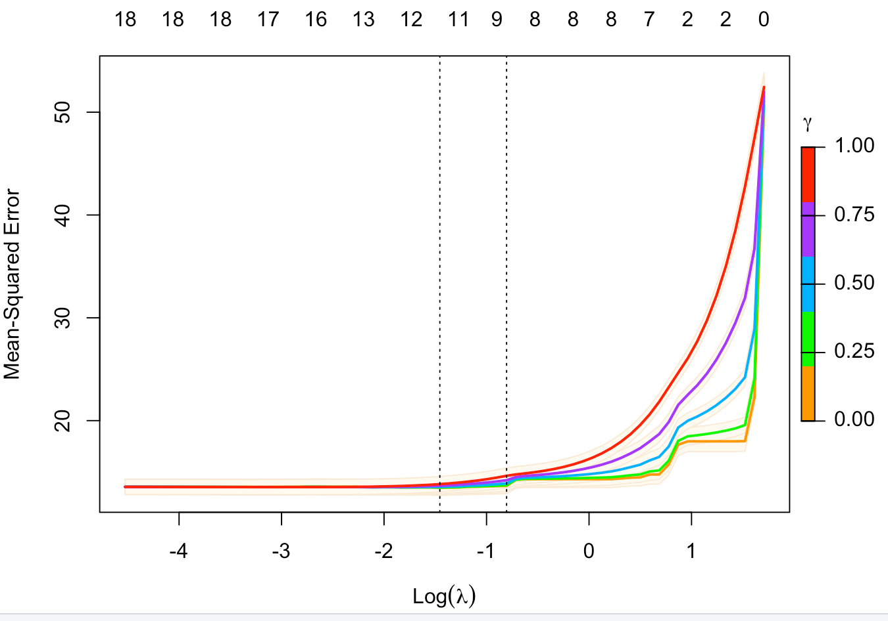
Lasso (Relaxed)
Significant Features (9)
Income, Kidhome, MntWines, MntFruits, MntMeatProds, MntFishProds, MntSweetProds, MntGoldProducts, AcceptedCmp5
Adjusted-R^2
0.728
Train RMSE
3.725
Test RMSE
4.664
Not a big difference from regular Lasso

Slide 16
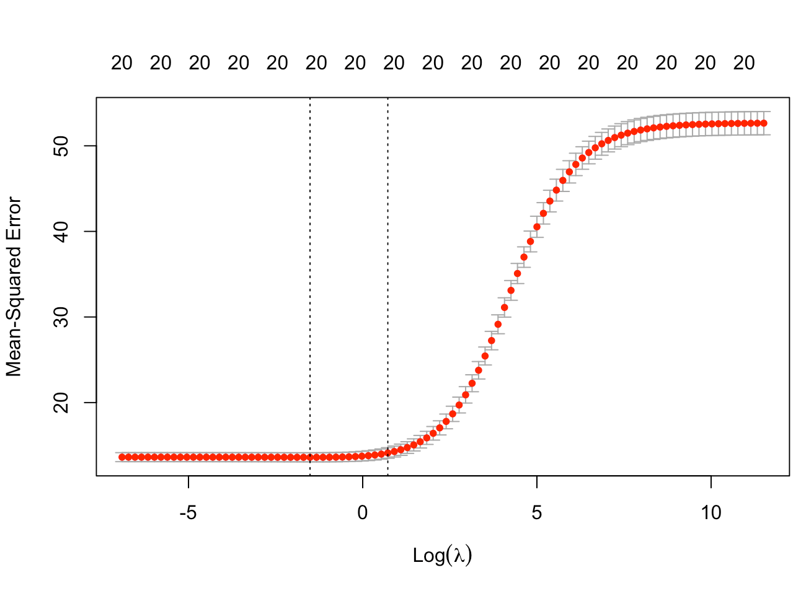
Ridge
Significant Features
All features
Adjusted-R^2
0.744
Train RMSE
3.705
Test RMSE
4.37
Test RMSE is only 18% larger than train RMSE now

Slide 17
PCA Analysis
4
Milad Sabouri

Slide 18
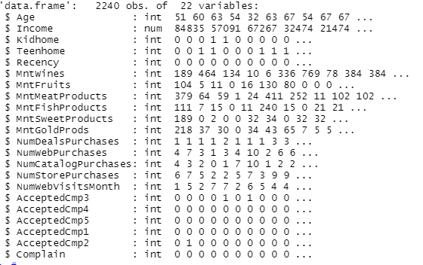
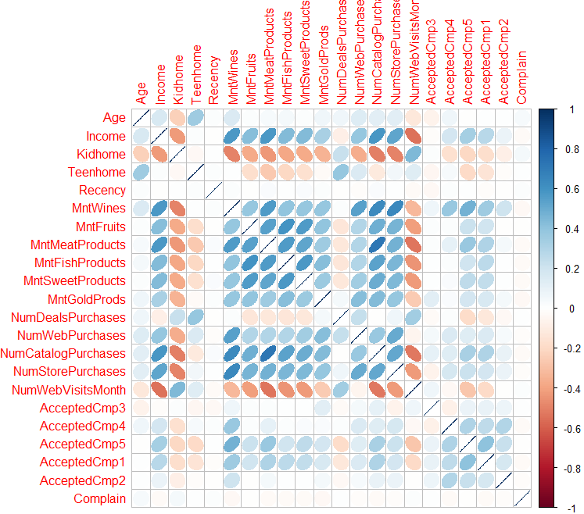
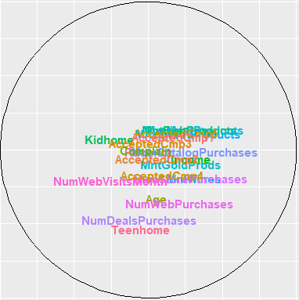
PCA: 1st Analysis - Overview

Slide 19
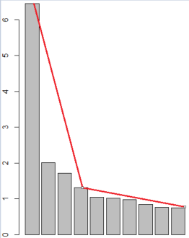
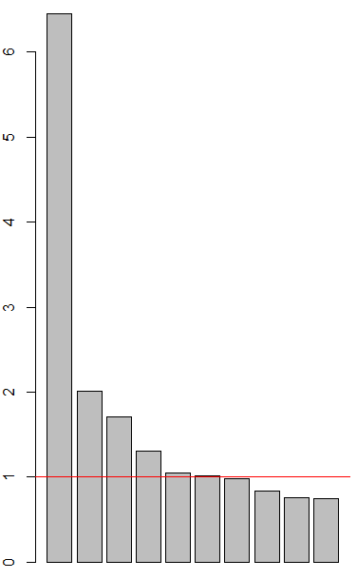
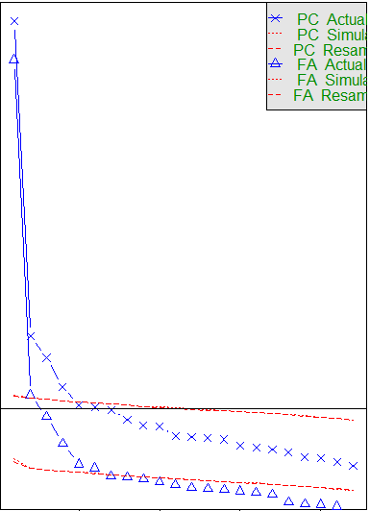
PCA: 1st Analysis - Find Significant Factors
Number of Factors = 4 / 6

Slide 20
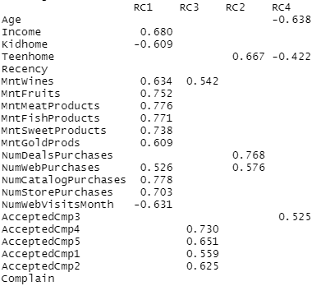
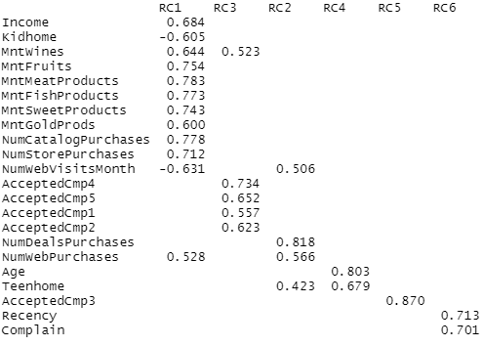
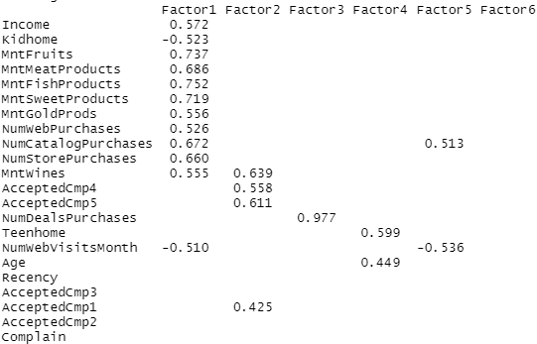
PCA: 1st Analysis - principal vs. factanal
principal / n-factor: 4
principal / n-factor: 6
factanal / n-factor: 6

Slide 21
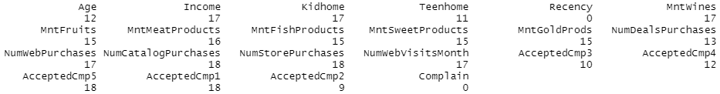
PCA: Cleaning Factors
Performing corr.test
Two variables have no correlations with others.
Four variables have correlations with more that 80% of other variables.

Slide 22
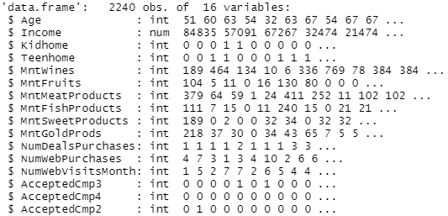
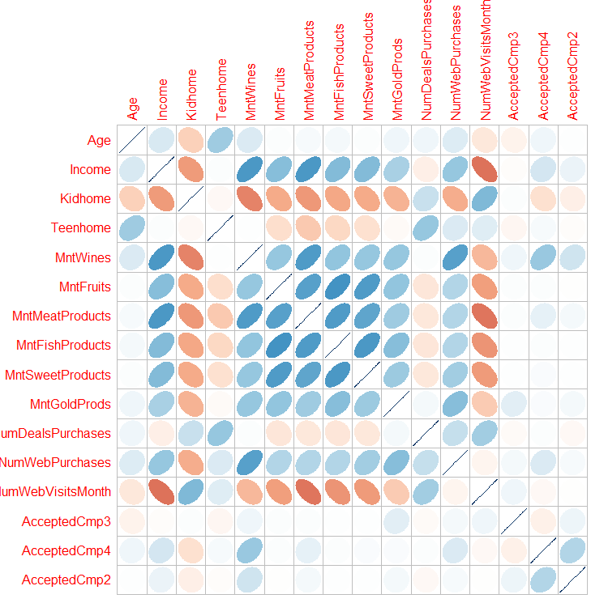
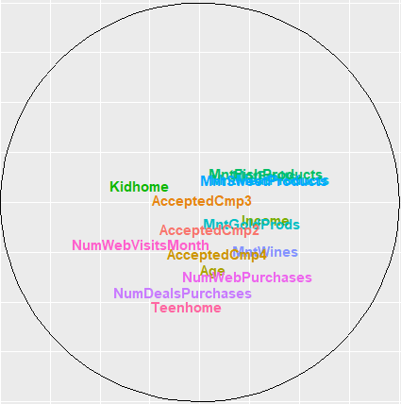
PCA: 2nd Analysis - Overview

Slide 23
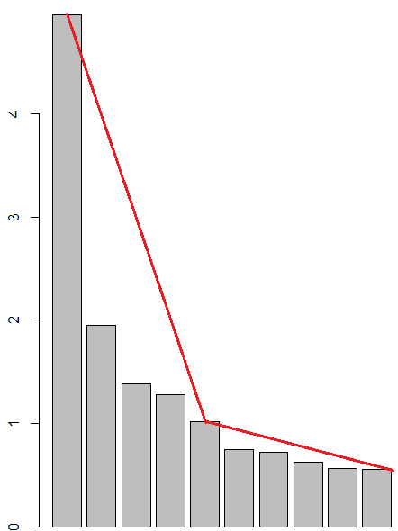
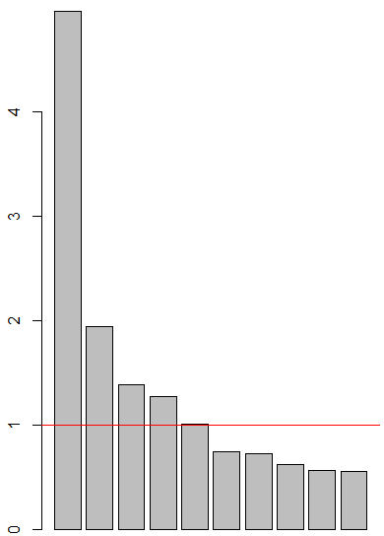
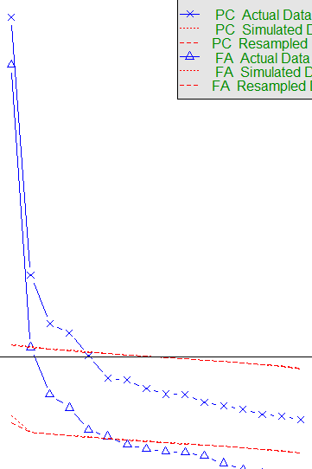
PCA: 2nd Analysis - Find Significant Factors
Number of Factors = 5

Slide 24
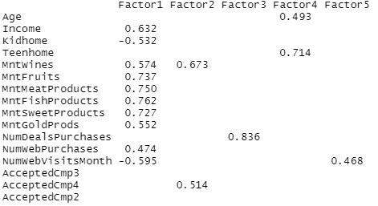
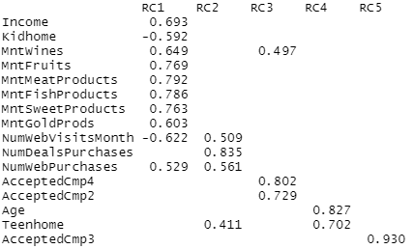
PCA: 2nd analysis - principal vs. factanal
principal / n-factor: 5
factanal / n-factor: 5

Slide 25
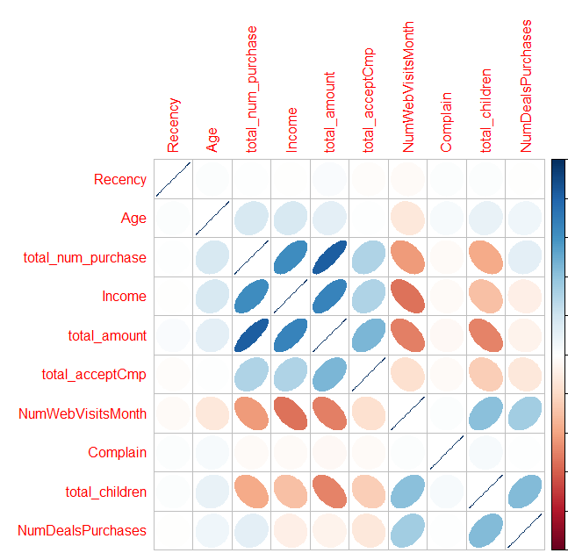
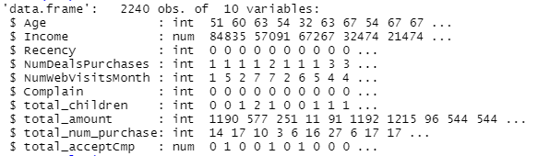
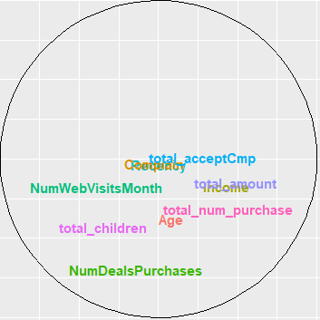
PCA: 3th Analysis - Overview

Slide 26
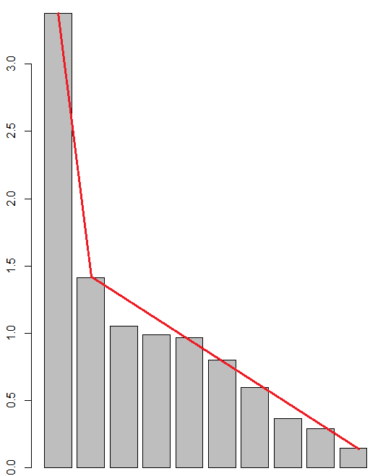
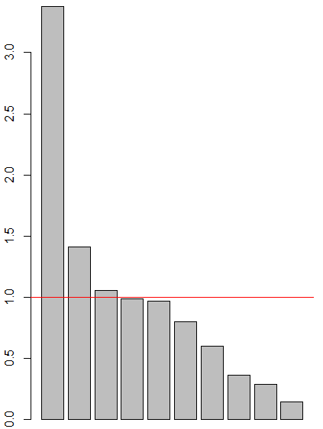
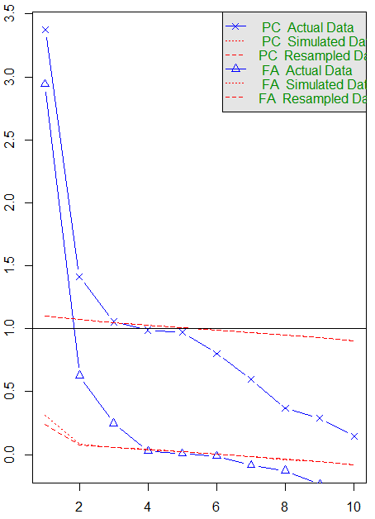
PCA: 3th Analysis - Find Significant Factors

Slide 27
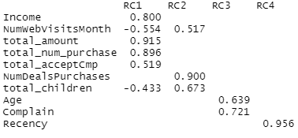
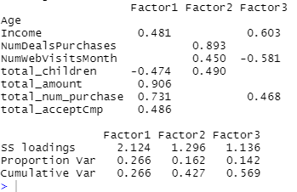
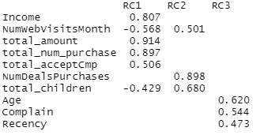
PCA: 3th Analysis - principal vs. factanal
principal / n-factor: 3
principal / n-factor: 4
factanal / n-factor: 3

Slide 28
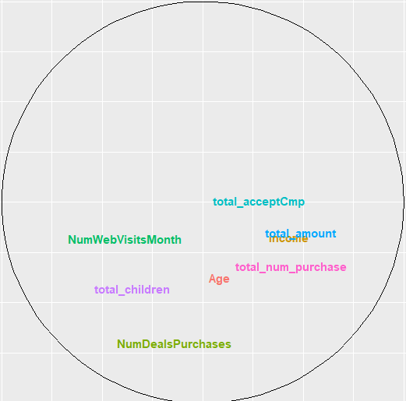
PCA: Final Thought

Slide 29
LDA Analysis
5
Chien-Lin Yang

Slide 30
LDA Analysis
LDA: Linear discriminant analysis is used as a tool for classification, dimensionality reduction, and data visualization.
Binary case / Categorical case

Slide 31
LDA - Binary Case
DV (Response): on accepted or rejected the offer in the last campaign —> Binary
Goal: to see if it is possible to predict the acceptance of customers
Method: Logistic vs. LDA

Slide 32
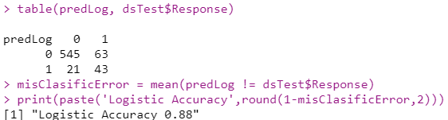
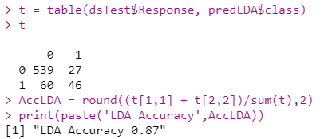
LDA - Binary Case
Confusion matrix
The similar results

Slide 33
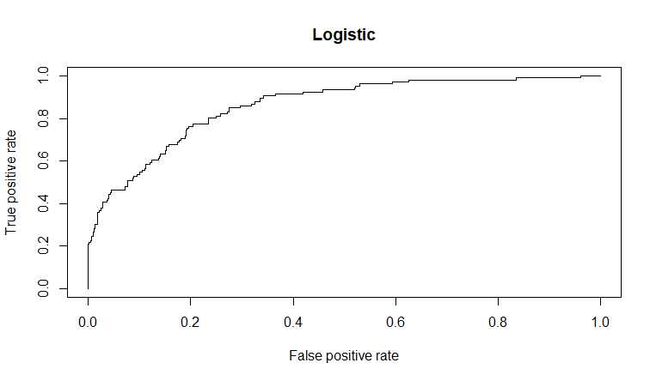
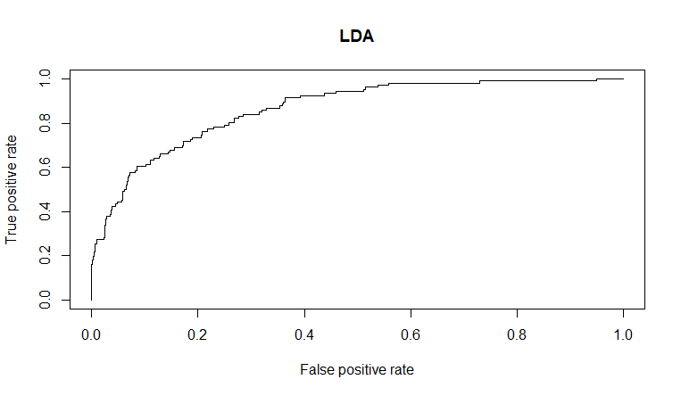
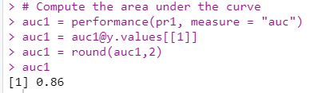
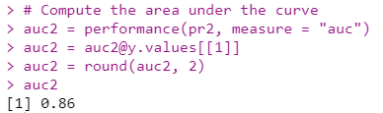
LDA - Binary Case
Summary
Logistic and LDA have the same performance in this binary case.
ROC curve

Slide 34
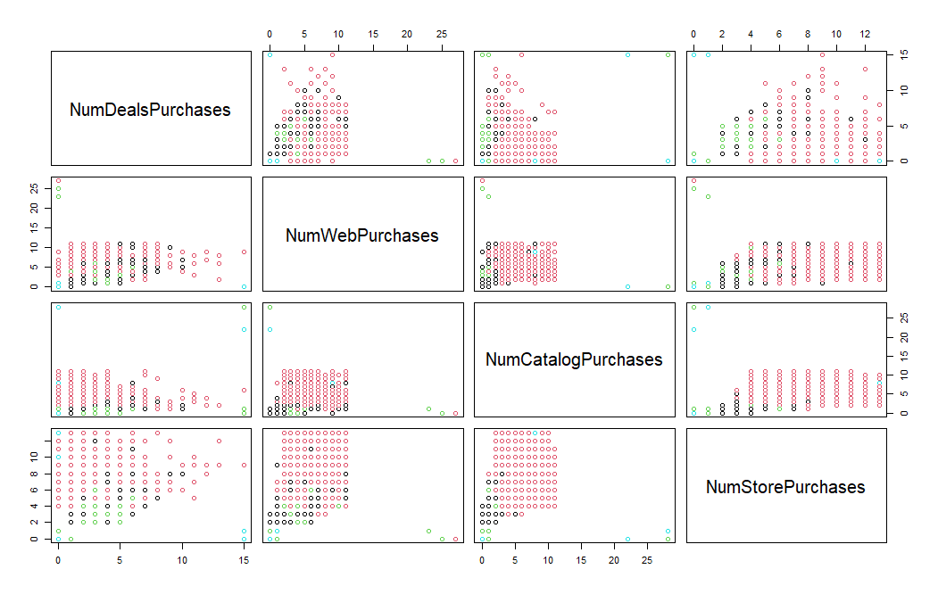
LDA - Categorical Case
DV (income_class): 5 levels,
Poor / Lower-Middle / Middle / Upper-Middle / Rich
IV: different purchasing ways
Goal: to see if it is possible to predict the income level of customers
Method: LDA

Slide 35
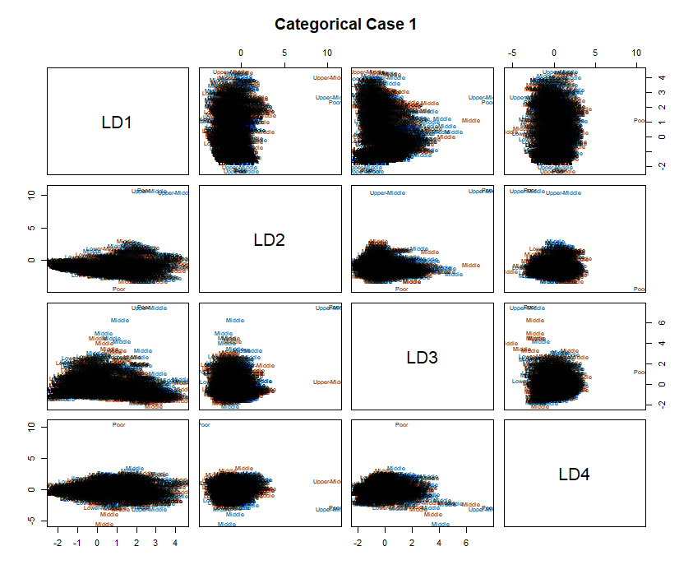
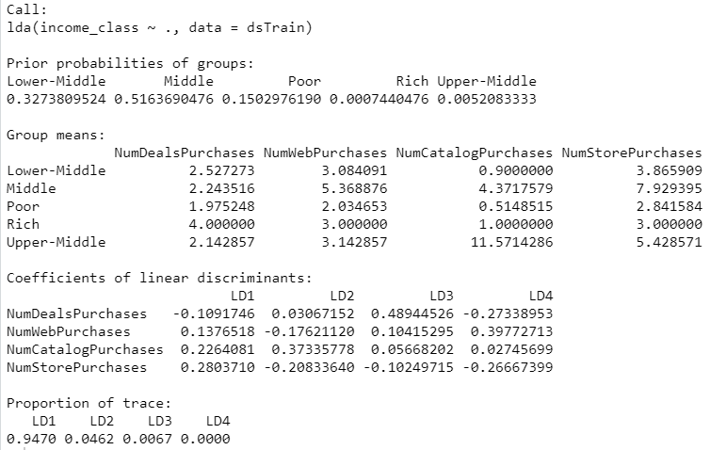
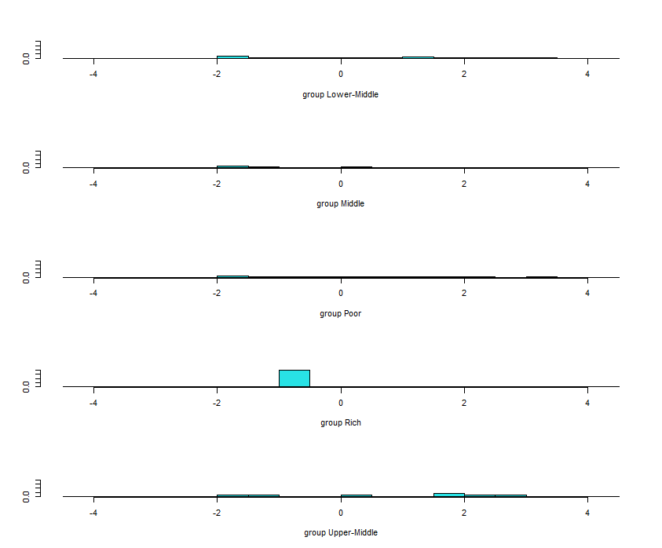
LDA - Categorical Case 1
Hard to separate

Slide 36
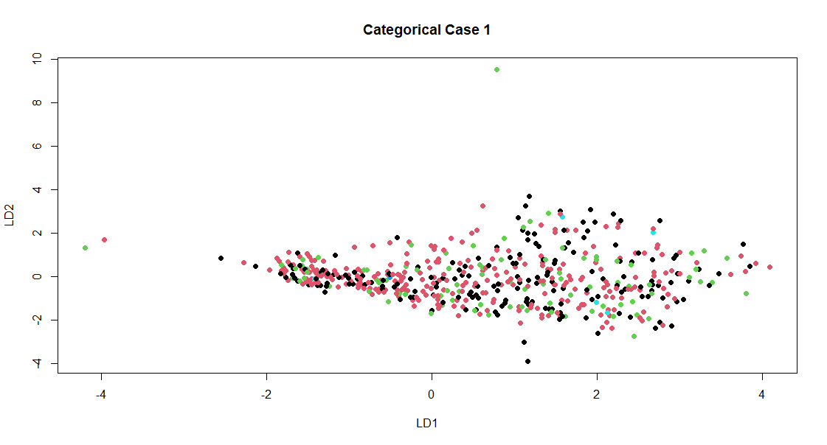
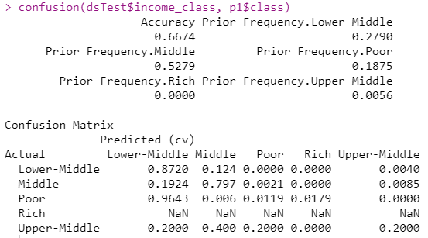

LDA - Categorical Case 1
Adjust levels (one observation)
Rich —> Upper-Middle
Remove an insignificant variable
NumDealsPurchases
Improve !

Slide 37
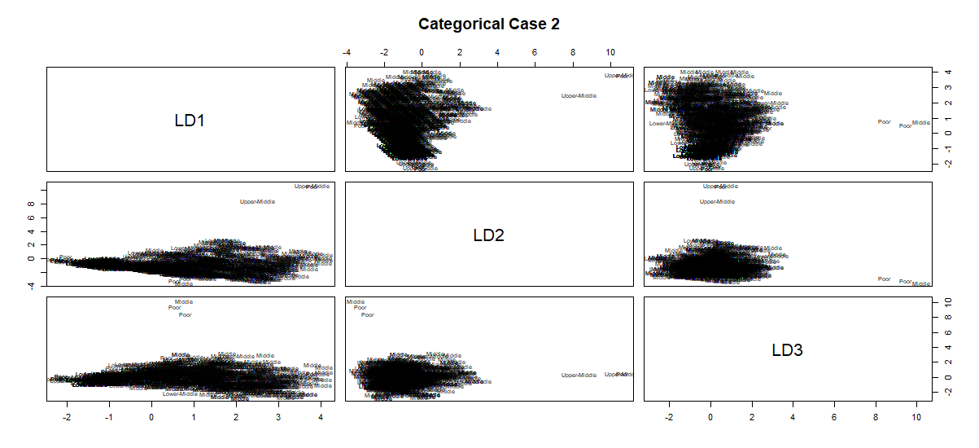
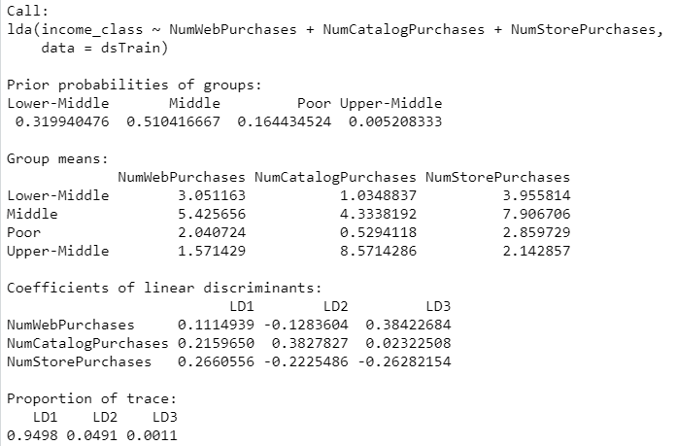

LDA - Categorical Case 2

Slide 38


LDA - Categorical Case 2
Better Performance
Prediction Accuracy 0.67 -> 0.72
However, the income level classification is still not easy to read.

Slide 39
LDA - Conclusion
Although the performance of classification is not good, LDA still gives us some insights and dimensionality reduction in the primary analysis for our marketing data.

Slide 40
Clustering Analysis
6
Pengju Zhang

Slide 41

General Clustering
All features are include in first phase
fit$stress is 29.74067
It is hard to tell each group from MDS

Slide 42


General Clustering
Elbow Method
Number of clusters about 3 as optimal one
Base on the dendrogram shown above, we can choose number of 2 as optimal clusters due to the clear two large equally separate group below height of 15.

Slide 43


General Clustering
Clusters Silhousette Plot
Silhousette width < 0.25 indicate the very little substantial structure has been found
Visualization for color in lower dimension space are mostly cross with each other, confirming the low relevance of the segmentation.

Slide 44


Clustering Conclusion
By using agglomerative hierarchical clustering (k-means), we can figure out 2 or 3 distinct type of clusters as shown above.
However each group has no clear boundary between others, it is hard to interpret the clustering plot.

Slide 45


Clustering Conclusion
By looking at histogram of Income, we could separate the whole as two main parts.
Critical point, mean = 52237.98
Label two classes as “Higher” and “Lower” then re-plot the clustering.
“Higher” are most on the left, “Lower” on right

Slide 46


Clustering with PCA
Elbow Method
Number of clusters about 3 as optimal one
Clusters Silhousette Plot
Silhousette indicate the optimal clusters of 2

Slide 47


Clustering with PCA

Slide 48
Thanks!

